Slide 1
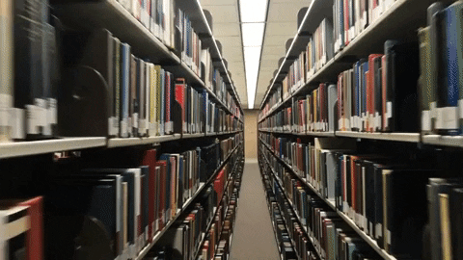
BookStore Information Management System
Group 6
Lecturer: DR.Tran Giang Son

Slide 2

Members
Phung Gia Huy BI11-110 Nguyen Dang Trung BI11-273 Nguyen Xuan Vinh BI11-286 | Nguyen Hoai Nam BI11-195 Hoang Duc Nghia BI11-198 Nguyen Dang Khoa BI11-122
Bui Hong Son BI11-236

Slide 3
Contents
Introduction
What?
Why?
II. Structure
Library
Package
Modules
III. Demo & Diagram
1. GUI demo
2. Database diagram
IV. Conclusion
1. Done
2. Not done

Slide 4

Introduction
1. What?
- An application:
+ for helping administrator manage the book information (book’s name, author, price,…) + revenue.
+ for helping customers see all books remained in bookstore + search book’s information
2. Why?
Easier + more convenient than writing on the paper => Minimize confusion and errors
Easy + convenient for customers looking for books they want to buy

Slide 5


Structure

Slide 6

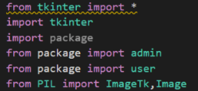
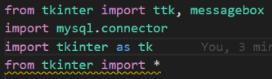
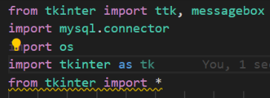
Library
library
library
Main.py
Admin.py
User.py

Slide 7

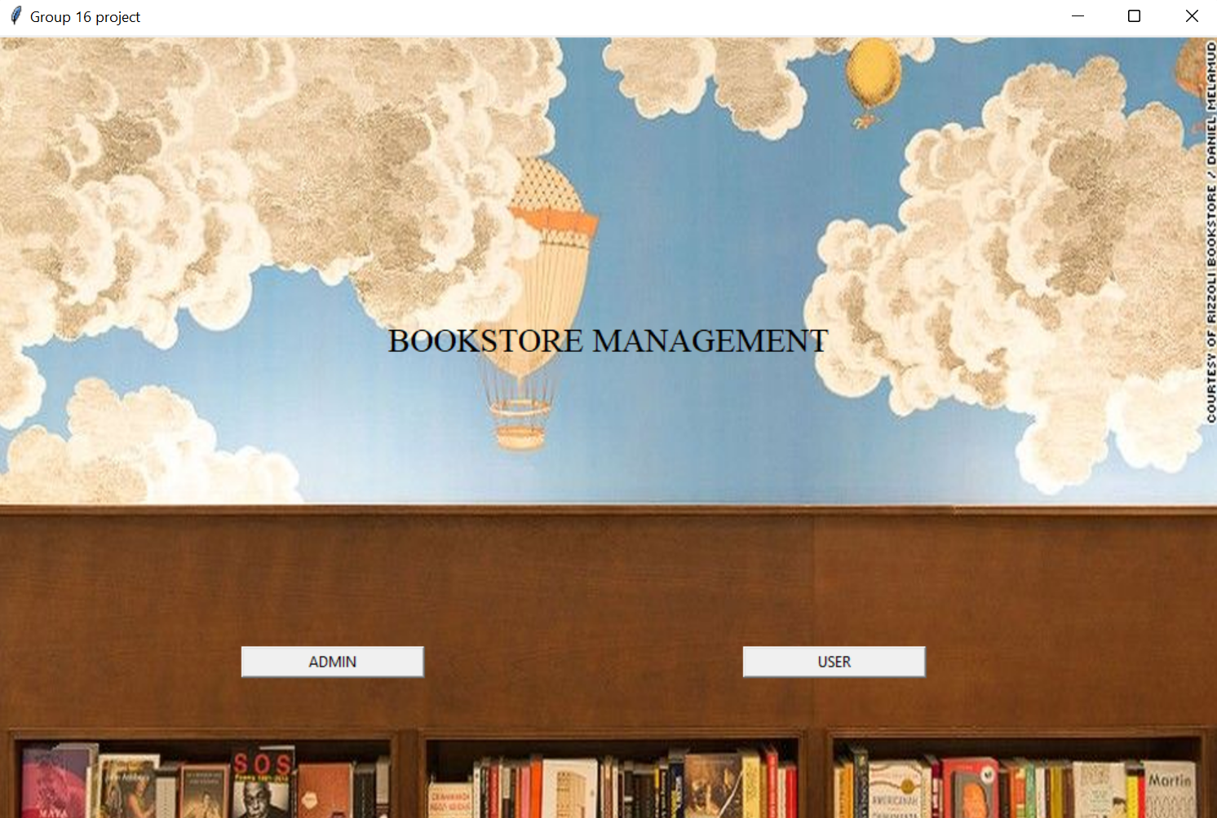
Packages
Have only 1 package which have 2 modules: Admin and User
+ Admin to add book’s information
+ User can search and use these information (book’s information)

Slide 8
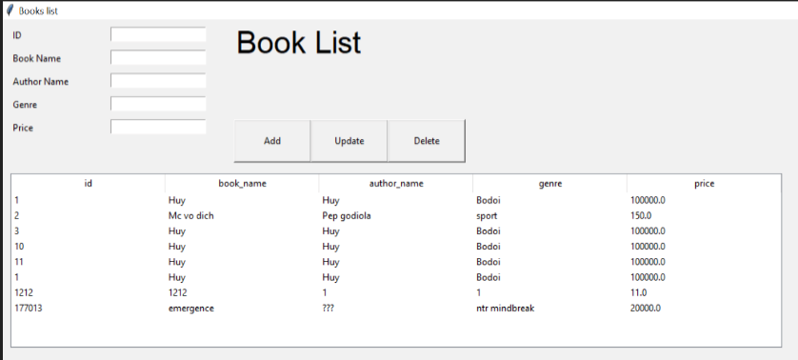
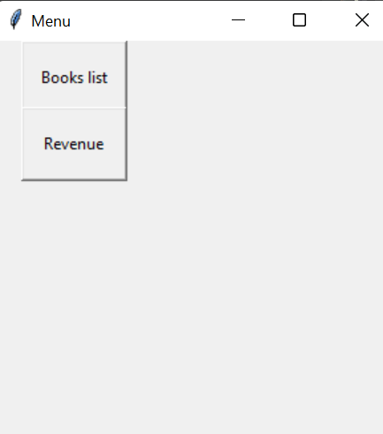
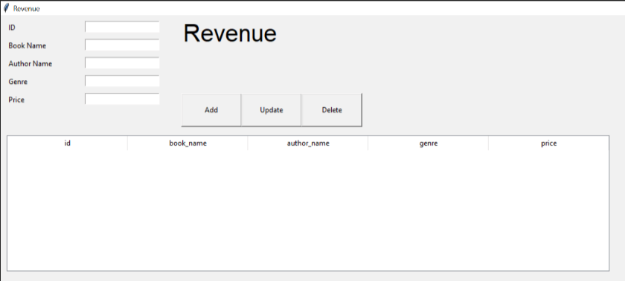
Modules: * First module: Admin
Book list window
Admin menu window
Revenue window

Slide 9
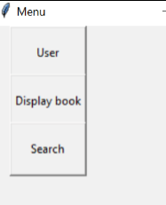
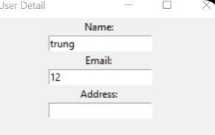
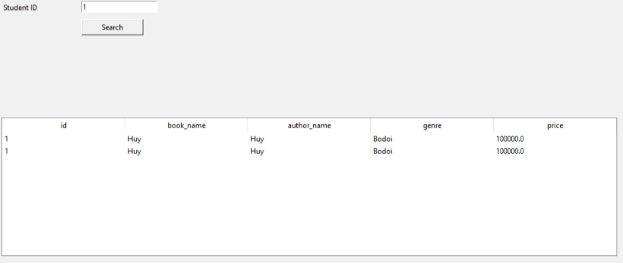
- Second module: User
+ User window
+ Register window
+ User login window
+ User display book window
(other will be shown in the demo)
User menu window
User detail window
Search window

Slide 10

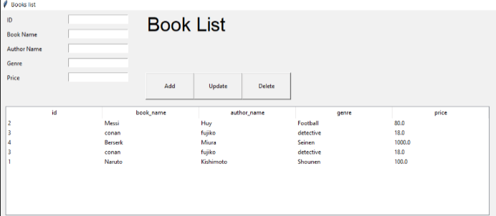
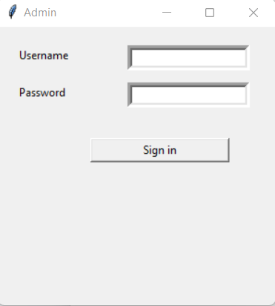
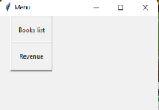
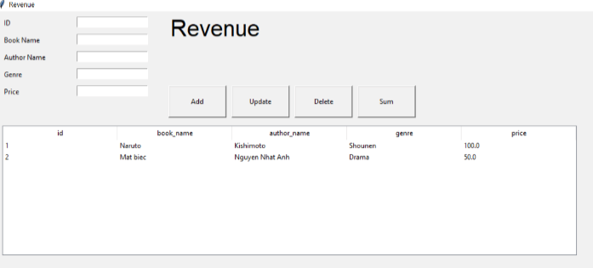
Demo
1. Admin:

Slide 11
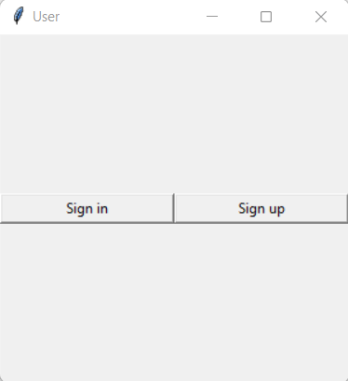
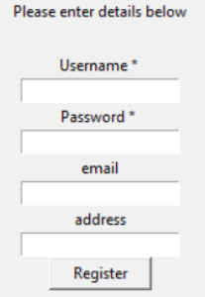
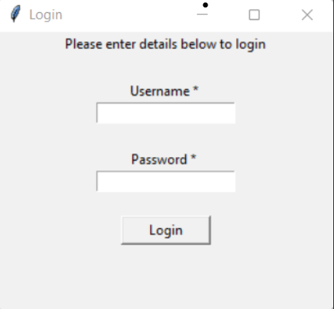
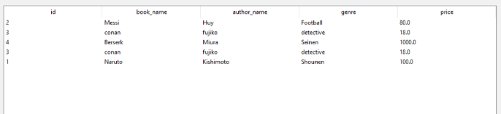
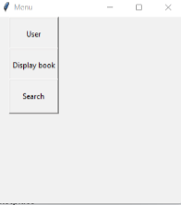
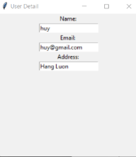
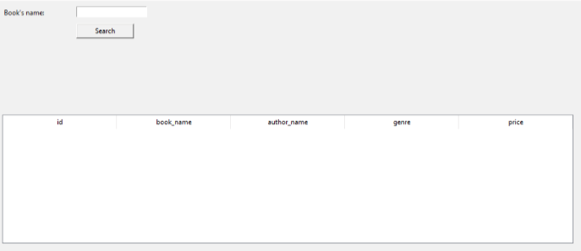
2. User:

Slide 12
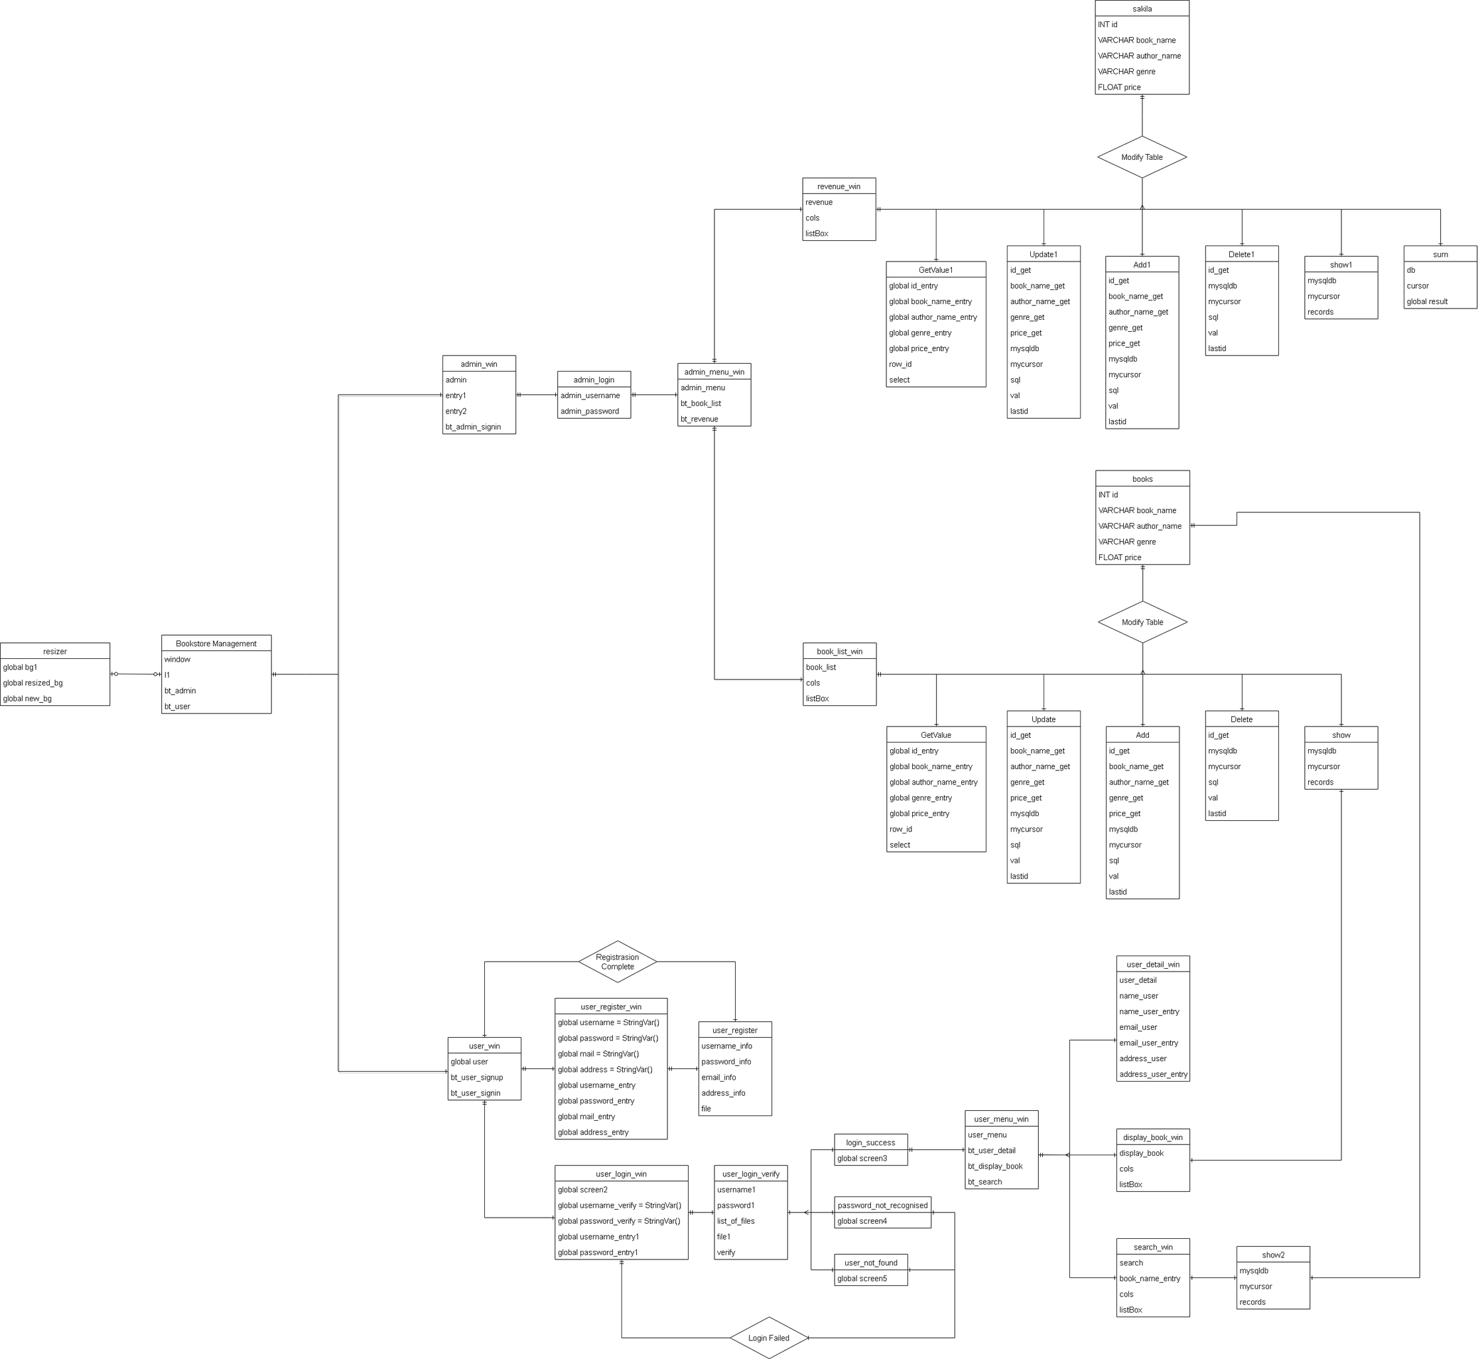
Database Diagram
Database diagram

Slide 13
Conclusion
* About what we have done: Have 2 main parts: Admin and User
- Admin:
+ Can add the book list (book’s information)
+ Have the revenue part
- User:
+ Have register and login
+ Have display book
+ Have search tool the book
* About what we have not done yet:
+ Music background (it nonstop unless the GUI close) and image background for all GUI windows
+ OOP and class (we can’t define specific object and class)
+ destroy() function (can’t apply for our main application)

Slide 14


Slide 15


